Slide 1
Week 2 (3) – Fundamental Data Structures
CST370 – Design & Analysis of Algorithms
Dr. Byun
Computer Science

Slide 2
Lecture Objectives
After completion of this lecture, you will be able to
  understand the basic terminologies of weighted graphs and trees in computer science.

Slide 3
<<< Course Instruction >>>
Read pages 30 – 31 (before “Trees”) in the textbook before moving on to the next slide.
  There are many terminologies of graphs in the section.
  Read the section carefully to get the accurate meaning of the terminologies.

Slide 4
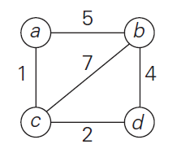
Weighted Graphs (1 of 3)
Example

Slide 5
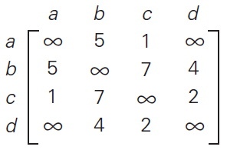
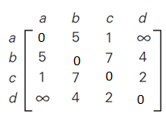
Weighted Graphs (2 of 3)
Representation in adjacency matrix
You can put 0’s on the main diagonal like below.

Slide 6
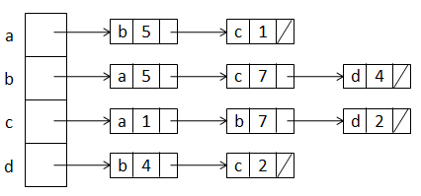
Weighted Graphs (3 of 3)
Example
Representation in adjacency list

Slide 7
Exercise
Represent the in adjacency matrix and adjacency list.
2
a
d
5
8
b
c
4

Slide 8
Important Note
Do not see the solution immediately on the next page.

Slide 9
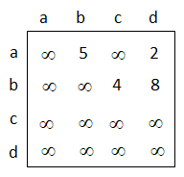
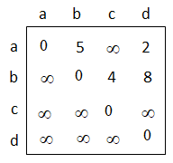
Solution (1 of 2)
Adjacency matrix
OR

Slide 10
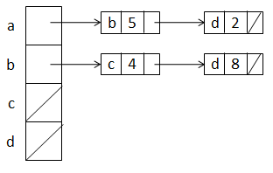
Solution (2 of 2)
Adjacency list
Note our convention of alphabetical order.
  For example, the vertex a has two edges to the vertexes b and d. When we represent it, we put the vertex b first and then put the vertex d.

Slide 11
Paths and Cycles
Study the terminologies such as
  “path”
  “connected”
  “connected component”
  etc.

Slide 12
Question
Is the graph connected? No.
e
a
b
c
d

Slide 13
Question
Is the graph connected? Yes.
e
a
b
c
d

Slide 14
<<< Course Instruction >>>
Read pages 31 – 35 (before “Sets and Dictionaries”) in the textbook before moving on to the next slide.
  There are many terminologies of trees in the section. Read the section carefully to get the accurate meaning of the terminologies.
  If you don’t understand the “first child-next sibling representation” in the textbook page 35, you can skip that part.

Slide 15
Free Tree, Rooted Tree, and Ordered Tree
Note that a tree is actually a graph (= connected acyclic graph).
  There are several different trees in computer science theory such as (free) trees, rooted trees, and ordered trees.
  Our main interest in the algorithm class is the binary tree and binary search tree.
  However, you should know the general terminologies in the section.

Slide 16
Puzzle: Palindrome Checking
Let’s assume that you have a very long character array.
How can you determine if the character array is a palindrome or not?
  Of course, your algorithm should be efficient.
Example
  racecar // Yes, it’s a palindrome.
  abcdefghijihgfedcba // Yes, it’s a palindrome.
  CSUMB //No, it’s not a palindrome.

Slide 17
Important Note
Do not see the answer immediately on the next page.

Slide 18
Solution
You can use two indexes i and j.
  i starts from the index 0 (= first character).
  j starts from the index n-1 (= last character).
  Check the characters in the index i and j.
  If they are not the same, return false.
  Otherwise, i increases by 1 and j decreases by 1 and check again.
  This way, you can keep checking the characters of i and j until they meet.
  If they meet, the array is a palindrome.

Slide 19
<<< Course Instruction >>>
This lesson is over.
  If you do not understand any part in the lecture, study it again.
  Otherwise, start the “week_2_4.ppt” to study the next topic.

